Slide 1

INFM 600: Information Environments
Week 11: Intro Data Visualization
Dr. Andrea Wiggins | November 9 & 10, 2016

Slide 2
Today’s Episode
Overview
Additional assignment feedback
Week 14…?
Graphical integrity
Demo: basic R plotting
Advantages & disadvantages of visualization
Break
Visualization rhetoric
Demo: R plotting details
Activity: Work on plotting project data

Slide 3
Additional feedback on QQ asst
In most cases, what looks like cheating was actually copying. Not much better.
If you copy and paste ANYTHING it must be in quotes, with an inline citation AND a reference.
References belong in their own section at the end. APA is not numbered or footnoted. Please look it up or visit a librarian.
We expect cites and references to be perfect in your final repository.
Some did not analyze the “series” of queries as a coherent set (partly because they weren’t coherent sets).
Small per-series deduction, but adds up if the purpose for running the query was also not mentioned.
Query-specific detail was not required. Series-level interpretation was.

Slide 4
Data Cleaning & Documentation
Most teams needed more details to support replication
Giving remaining number of rows & columns at the end is the most minimal way to do that
0.25 deduction for lack of minimum info for verifying replication
In most cases, also needed more up-front detail such as how many rows/columns (recall feedback from Info Seeking)
Next steps
Update your repo based on assignment feedback & meetings
Think about best presentation format for your specific audience

Slide 5
Graphical Integrity (Tufte)
Failing to tell truth, intentionally or not, is lying
Understand perception: changes with context, experience
Visual comparisons of area are difficult, proportions hard to judge
Ways to combat distortions
Use tables to show numbers (where suitable)
Compare effect “size” in graphic to size of effect in data
Don’t distort data measures in favor of decor
Keep scales consistent & labeled
Multiple scales in one plot tends to confuse
Vary only one dimension at a time
Make sure both direction and magnitude are accurate
Show full trends for context
Compare results across subsets as well as aggregates

Slide 6
Six Principles
Numbers should be represented proportionally
Clear, detailed, thorough labels are required: explain the data!
Show data variation, not design variation
Use standardized units for comparisons (time series w/ $)
Number of variable dimensions (scales) should not exceed dimensions in data
“Graphics must not quote data out of context”
Others?

Slide 7
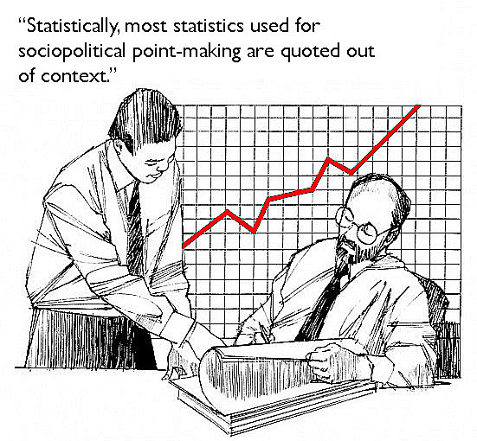
http://www.porkcircus.com/2015/08/29/statistics/

Slide 8
Lying & Misleading (Cairo, 2015)
Misleading isn’t always intentional, sometimes it’s careless
Intentional misinformation happens when…
Not showing much data: hiding relevant but inconvenient data
Showing data inaccurately: inappropriate graphical distortions
Obfuscating the data: showing too much to interpret
Our main concern: showing data accurately
Most infographics show cherry-picked stats
Oversimplification removes nuance and context
Appropriate detail depends on goal: quick overview vs exploring
Validity is more important than visual appeal

Slide 9
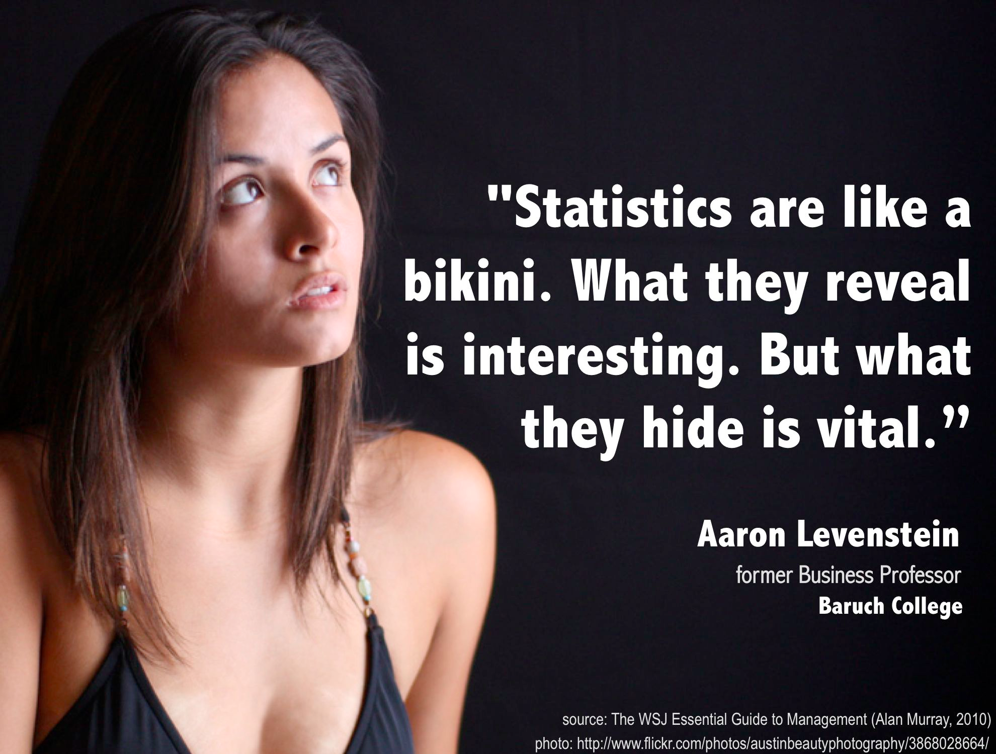

Slide 10
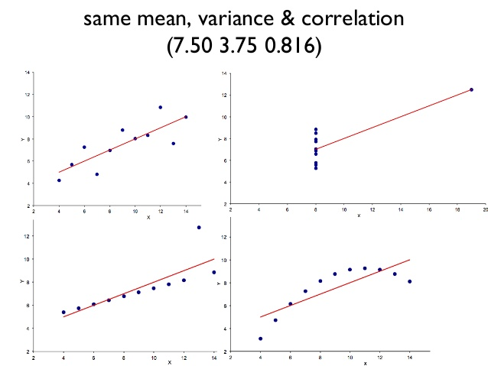
http://www.slideshare.net/mgaewsj/devops-metrics-lies-damned-lies-and-statistics

Slide 11
Demo #1: Simple Plotting
Initial plotting basics
Data is on Canvas, Week 11 module: Sample1.csv

Slide 12
Limitations of visualization
Causes: who introduced mistakes (intention hard to assess)
Designer vs user
Effects
Cognitive, emotional, social
Visceral, behavioral, reflective
Users: confusion, distraction, manipulation, limit reflection, delay
Countermeasures: possible remedies
Fundamental vs focused changes, substantial vs superficial modifications, cosmetic vs substantive ones
Should align with seriousness of the specific disadvantage

Slide 13
Classification: Cause x Effects
What it shows us
Similar levels of emotional issues regardless of cause
More cognitive issues induced by designers
More social issues induced by users
Examples
Cognitive + designer → Over-complexity/simplification
Cognitive + user → Overload
Emotional + designer → Disturbing
Emotional + user → Personal preferences
Social + designer → Unequal participation
Social + user → Cultural influences
How could you use this classification in practice?

Slide 14
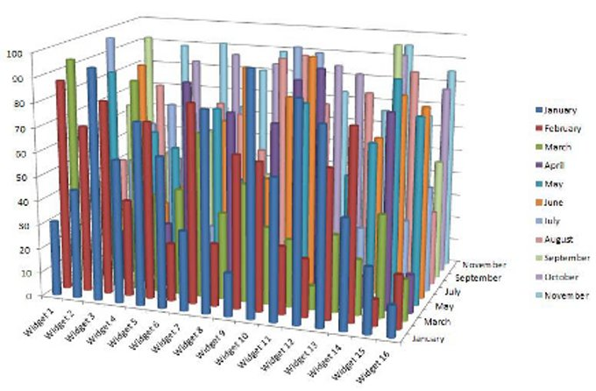
http://cdn.information-management.com/media/newspics/Bling_fig3.jpg

Slide 15
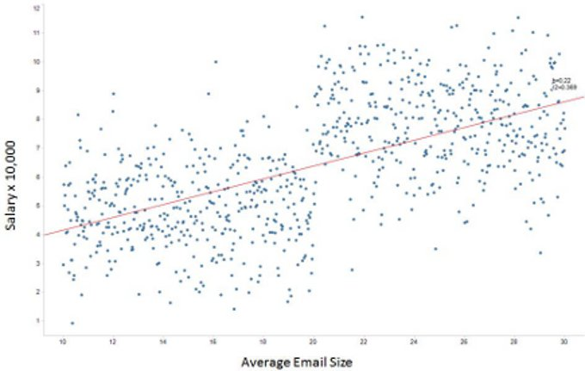
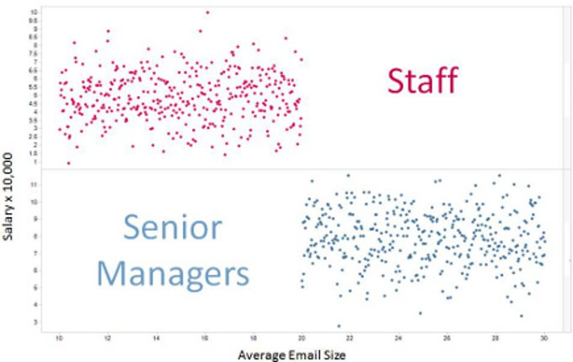
http://data-visualization-software.com/dangers-of-bling-data-visualizations/

Slide 16
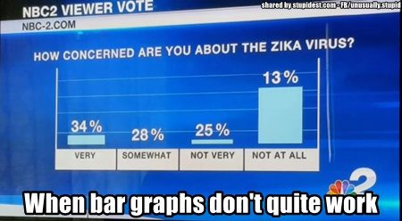
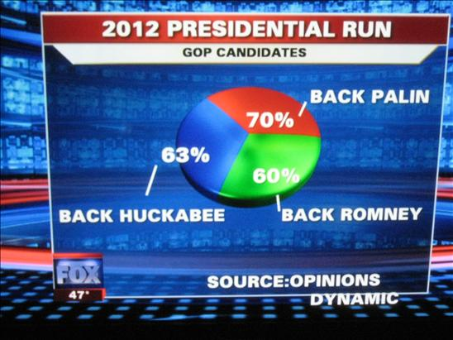

Slide 17
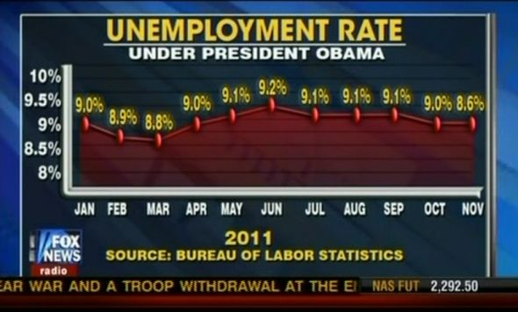
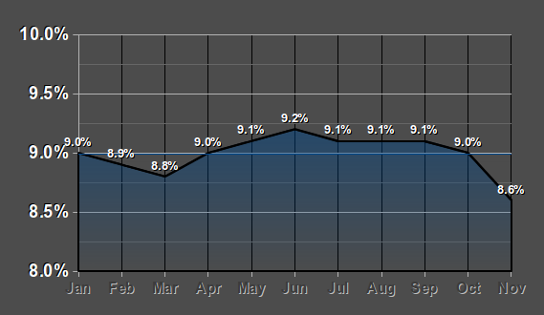
http://freethoughtblogs.com/lousycanuck/2011/12/14/im-better-at-graphs-than-fox-news/

Slide 18
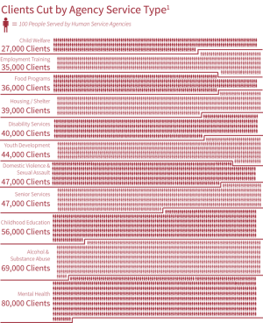
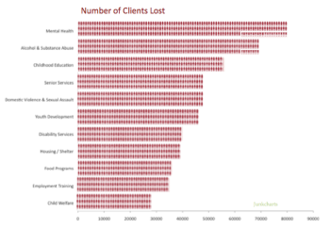
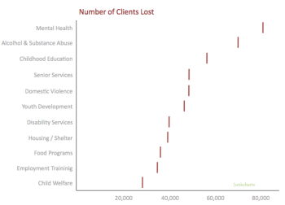
http://junkcharts.typepad.com/junk_charts/2016/06/a-tufte-fix-for-austerity.html

Slide 19
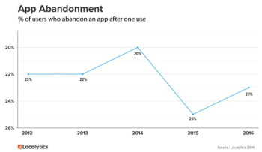
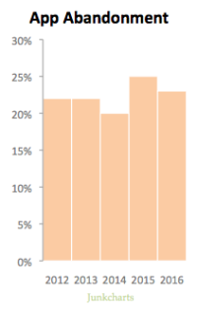
http://junkcharts.typepad.com/junk_charts/2016/06/what-doesnt-help-readers-on-the-chart-and-what-does-help-off-the-chart.html

Slide 20
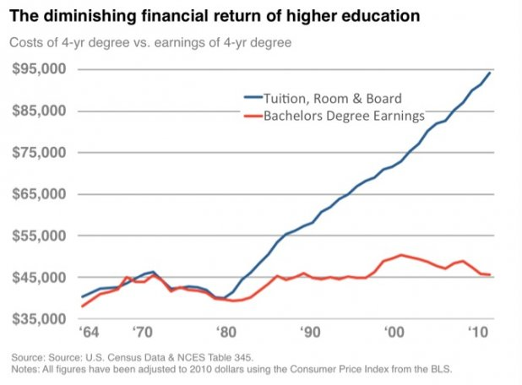
Notes:
a key fact that wasn’t on the chart: the cost of not going to college has diminished even more. Than means, your prospects as a high school graduate are a lot worse than your prospects as a college graduate.
yearly income a college grad can expect is about $45,000 in 2010. That’s per year. Over an average working lifetime (say, 43 years assuming retirement at age 65), that gives you an income of $45,000 * 43 = $1,935,000. Subtract that expensive college education ($95,000) and your net earnings are $1,840,000. Compare that to your average high school grad. They can expect to earn $1,300,000 over their lifetime

Slide 21
Discussion: Advantages
What are some of the reasons that we rely on visualizations?
Efficient visual processing of large amounts of complex data
New ways to view and understand the data
Identify potential relationships & patterns
Communicate results to others
When used diagnostically, helps ensure quality of data (http://www.boostlabs.com/benefit-of-data-visualization-3-crucial-insights-into-your-data/)
Is the data complete?
Is the data valid?
Is the data well-organized?
Notes:
How would we know whether data are complete, valid, organized well based on visualizations?

Slide 22
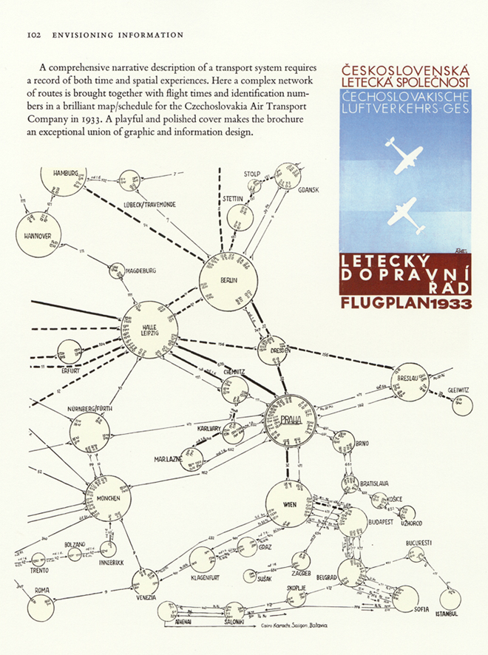
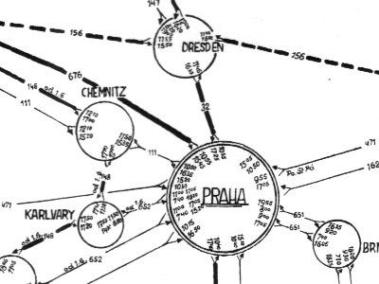

Slide 23
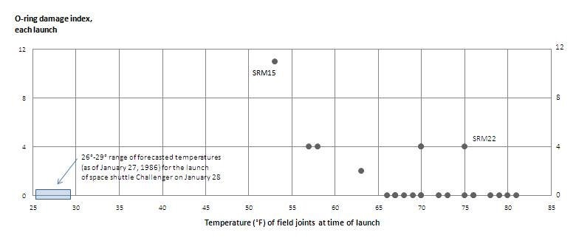
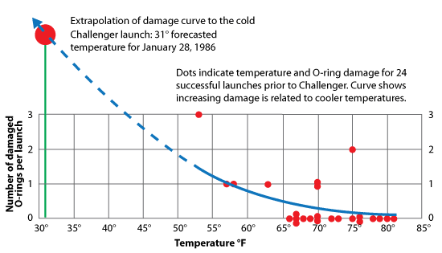
http://claritystrategic.com/index.php/companion/68-examples/189-challenger

Slide 24
Report of the Advisory Committee to the Surgeon General, Smoking and Health. Washington DC, 1964.

Slide 25
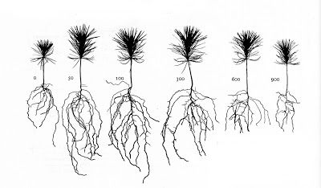
H.L. Mitchell. (1939). The Growth and Nutrition of White Pine Seedlings in Cultures with Varying Nitrogen, Phosphorus, Potassium and Calcium. The Black Rock Forest Bulletin No. 9, pp. 70.

Slide 26
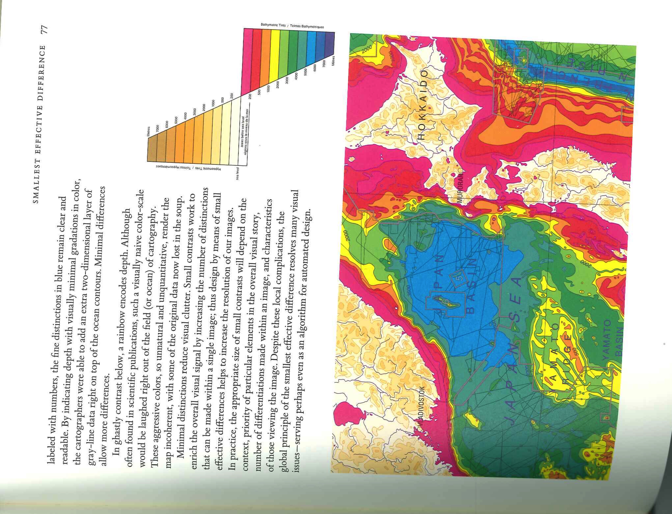
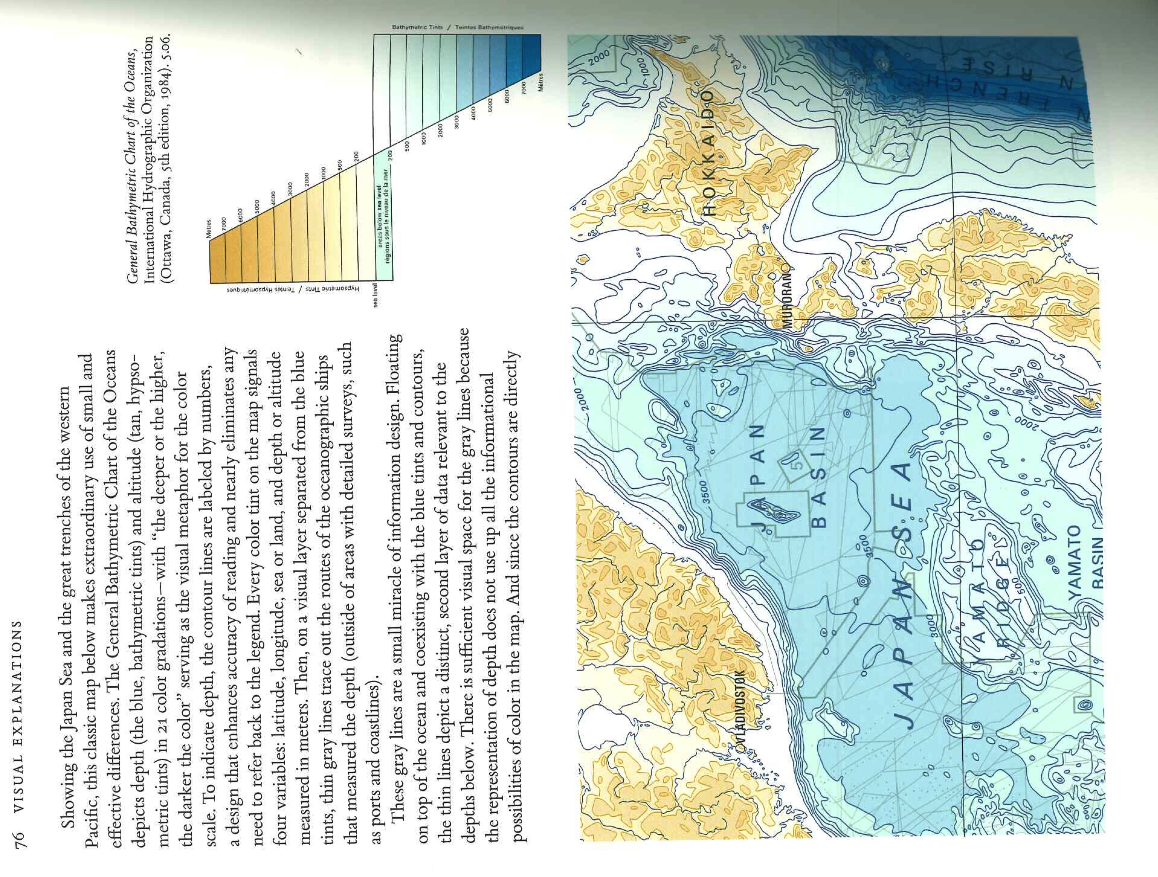

Slide 27
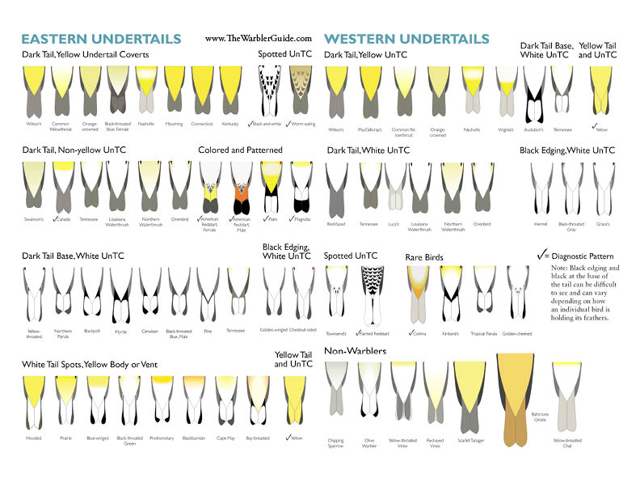

Slide 28
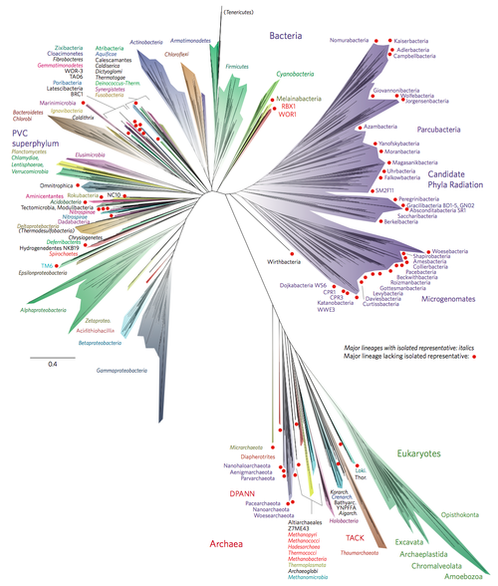
http://www.nature.com/articles/nmicrobiol201648

Slide 29
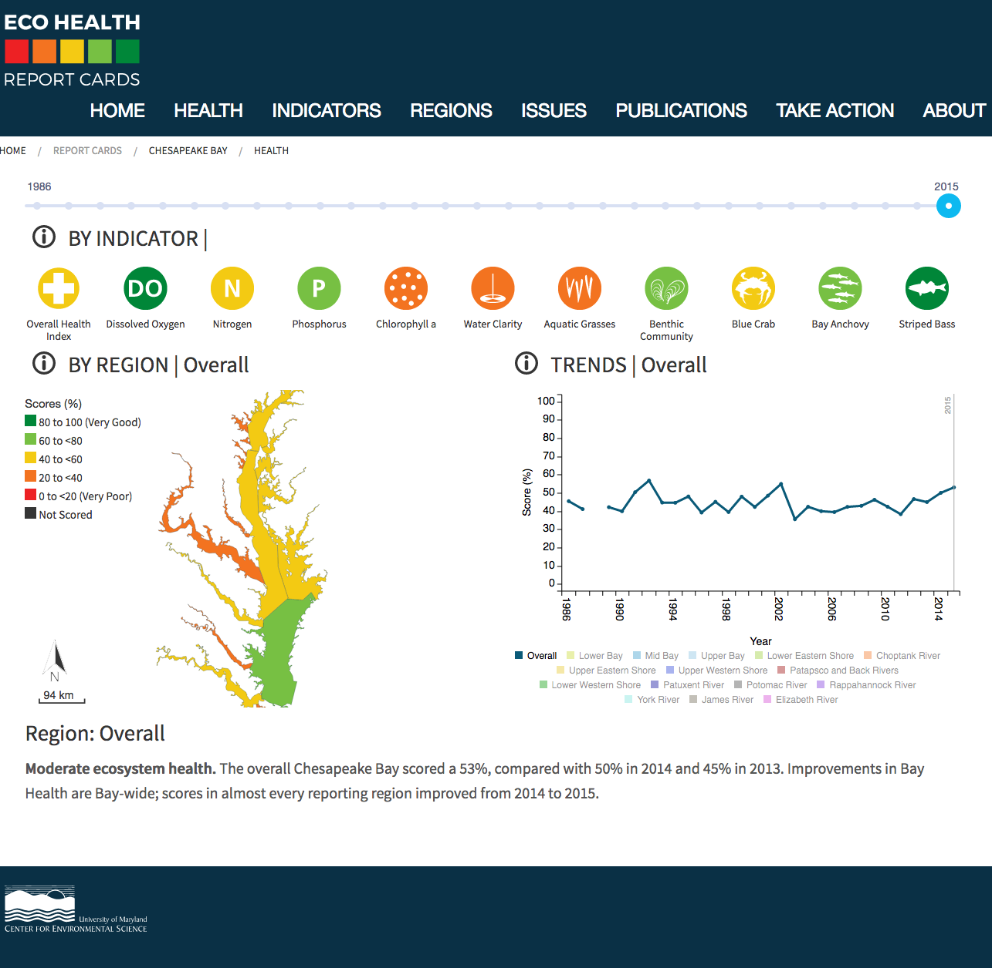

Slide 30
Break
10 minutes

Slide 31
Visualization rhetorics
Narrative info viz: both exploratory and communicative
Relies on persuasive rhetorical techniques to tell a story
But how does this impact interpretation?
Framework: Editorial layers
Like Cause(Designer) at multiple levels
Data: what to include and exclude, outliers, scaling, aggregation
Representations: making choices on mapping data visually
Annotations: focusing users’ attention; textual, graphical or social
Interactivity: constraining choices to influence what is viewed

Slide 32
Observed rhetorics
Information Access
Omission, metonymy
Provenance
Data provenance, representing uncertainty, identifying designer
Mapping
Obscuring, metaphor & metonymy, contrast, classification, redundancy
Linguistic-based
Typographic emphases, irony, similarity, individualization
Procedural
Anchoring, filtering
Notes:
Metonymy: manipulate part-whole relationships to simplify, e.g. averaging, aggregating, etc.

Slide 33
Demo #2: More plotting
How to:
Set axis labels and plot title
Change axis markings
Add and change a plot legend
Adjust size of points
Save plots!

Slide 34
Activity: Plotting in R
Work in parallel with your teammates
Use your data set, or a sample of it, and help( ) as needed
Try the following plotting functions:
stripchart( )
hist( )
boxplot( )
plot( )
qqnorm( ) followed by qqline( )

